Slide 1
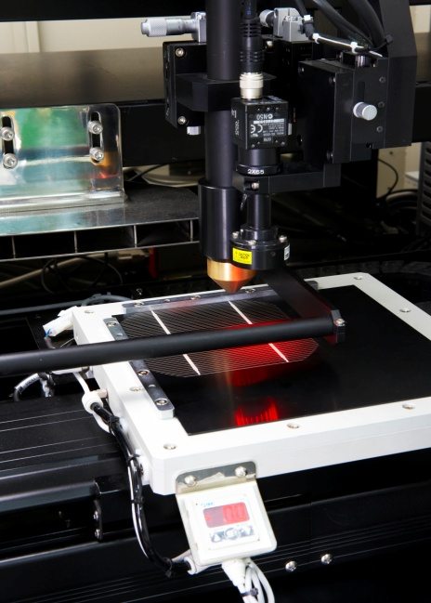
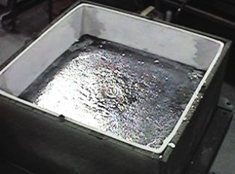
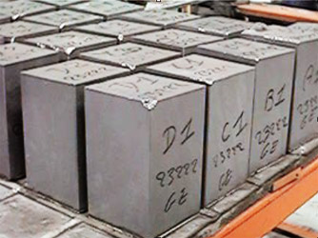
제어 S/W Review
Femto Science Inc.

Slide 2
Contents
제어시스템 구성
2. S/W GUI
3. Recipe

Slide 3
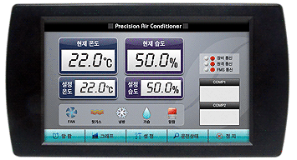
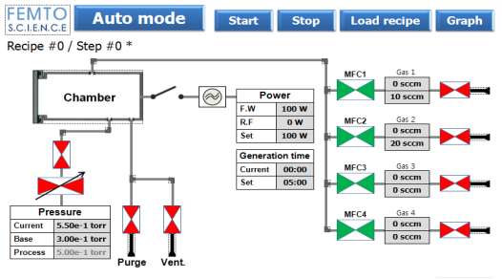
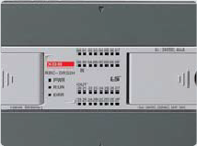






제어 시스템 구성
Panel PC
PLC (AD/DA)
RS232
Input / Output (ON/OFF)
AD/DA (Analog)
LF Gen.
Switch
Vacuum/Gas Valve
MFC
Pirani
Gauge

Slide 4
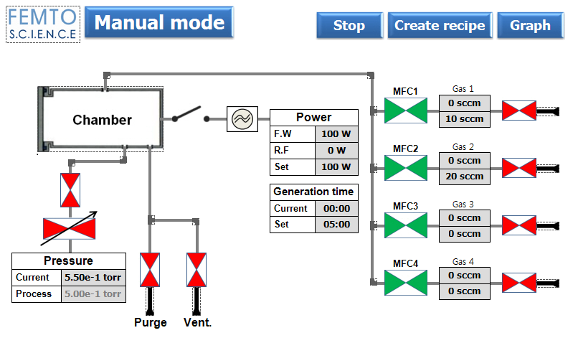
GUI (1)
Auto mode screen
Load / Modify recipe.
Start / Stop process.
Run process automatically.
Display graph.
Manual mode screen
Create / Modify recipe.
Control All H/W Component.
(LF-Generator, MFC, Valve, …)
Display graph

Slide 5
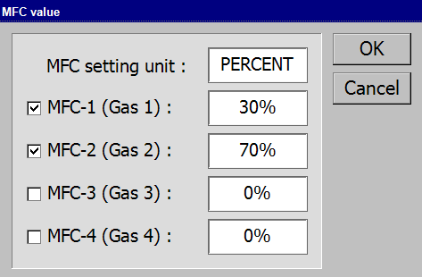
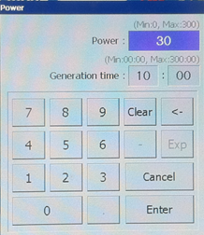
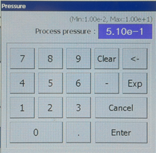
GUI (2)
Manual mode screen
MFC setting UI
Power setting UI
Pressure setting UI

Slide 6
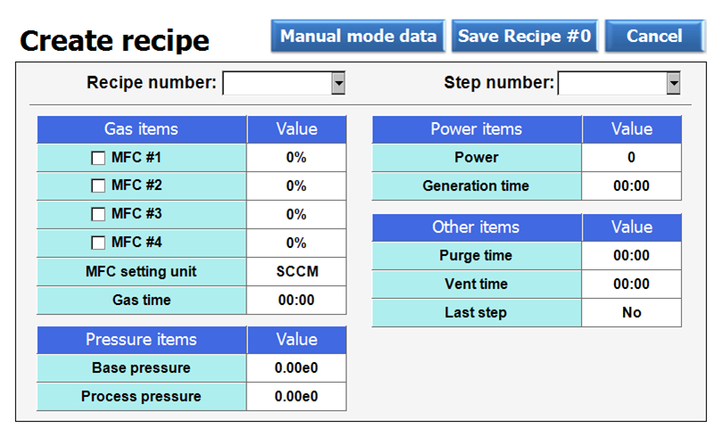
GUI (3)
Manual mode screen
Create / Modify recipe.
Support up to 10 recipes.
Support up to 10 steps in
each recipe.
Each step have
  Gas items.
  Pressure items.
  Power items.
  Other items.
Recipe screen
This item should be YES if the current step is last step.

Slide 7
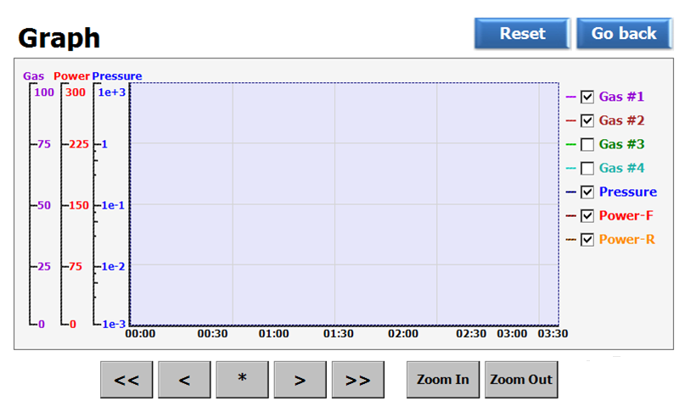
GUI (4)
Manual mode screen
Show time based graphs of gas, pressure, power.
Toggle each graph.
Support scroll & zoom in/out.
Graph screen
Toggle each graph.

Slide 8

Recipe
Sequence of recipe
Recipe screen
Pumping out
No
Base pressure
Yes
Open gas valves & control gas flow
No
Wait for gas stable time
LF Power ON
Purge
Please refer to this doc. for details of GUI & Recipe
=>
Last step?
Yes
Vent

